Slide 1
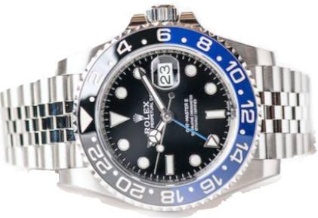
Rolex - Price Estimator
Classical Project - Cohort: Alpha 2
CODESMITH
Team: PEANUT BUTTER
Paul Yim + Natalie Umanzor + Silvia Kocsis
December 2022

Slide 2
ROLEX - Data Sources
Web Scraping with SELENIUM
Sold items on https://www.watchcollecting.com/
Currency on https://www.ofx.com/en-us/forex-news/historical-exchange-rates/

Slide 3
ROLEX - Technical Challenges
SELENIUM
Installation on MacOS and on Windows
WebDriverWait
DATA
Typos and Missing Values -> Python Code, Median Values
Date Format DDMMYY, MMDDYY, YYMMDD
Too Many Different Values -> Manual One Hot Encoding in Python
Only 846 records
TEAM WORK
Exchange Code and Data Between Team Members
Waiting on Results From Other Team Members
TECHNICAL
M1 chip prevents certain packages from running
Notes:
DDMMYY is not good for sorting.

Slide 4
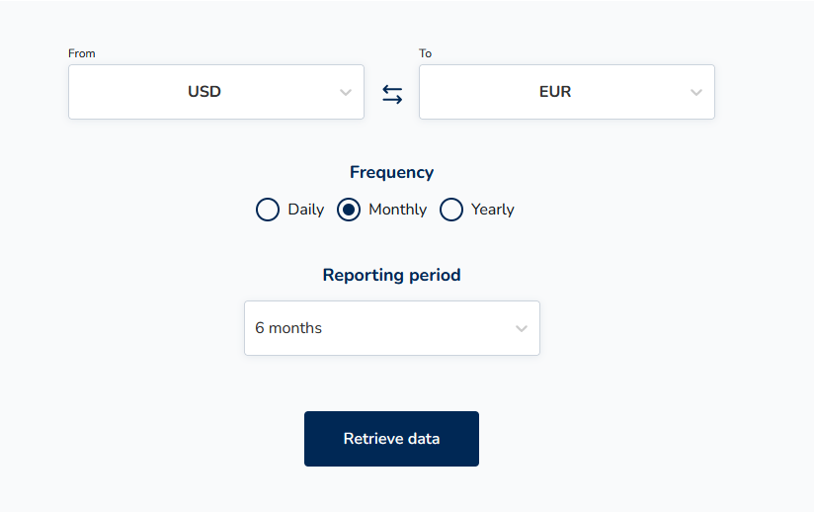
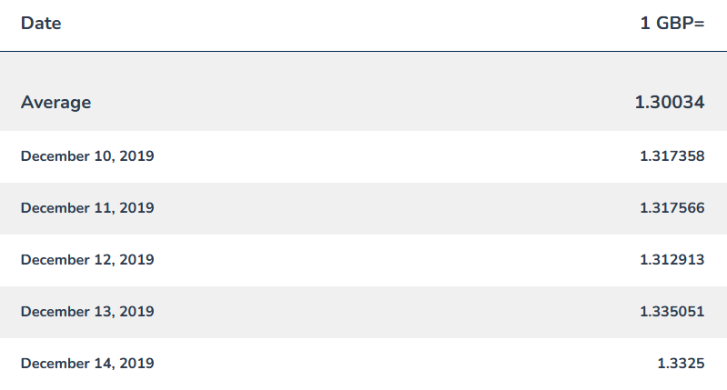
Selenium Currency
Utilizing selenium changed settings on website to get past 3 years worth of data
Used selenium to parse through tables to get correct exchange rate (some days were missing)

Slide 5
ROLEX - Models / Hyperparameters
Tested LinearRegression and LightGBM Regressor
Linear Regression Model gave Rsquared error of 0.5415
With PCA set to 0.95 gave R squared error of 0.5419
LightGBM Regressor with optimized hyperparameters gave Rsquared of 0.6417
Hyperparameters were optimized utilizing 1000 iterations of a random grid search
Model was split 80/20
Final Model was trained over full data set and serialized
If tested on test data set gave Rsquared of 0.8856

Slide 6
ROLEX - Evaluation Metric
Evaluation metric used were Mean Squared Error and R squared
MSE was used to find best hyperparameters of the model
Final Model gave R squared value of 0.6417

Slide 7
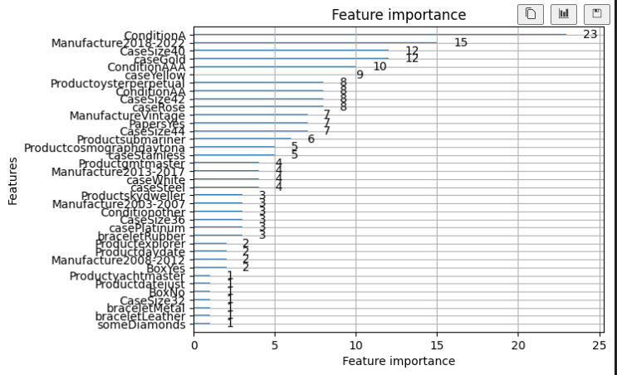

Slide 8
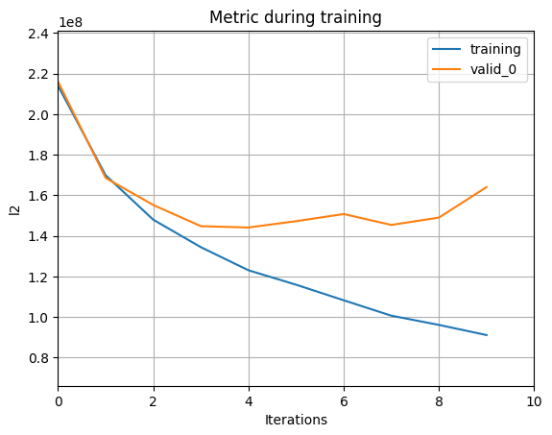

Slide 9
ROLEX - Flask App

Slide 10
Thank You
Questions?

Slide 11
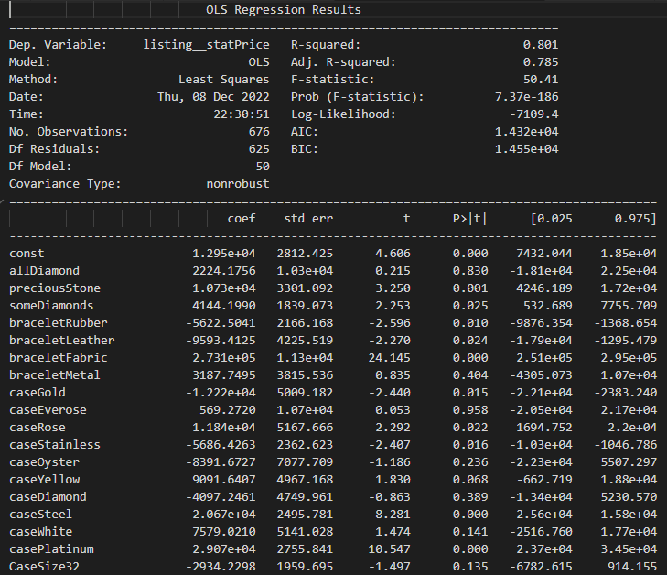

Slide 12
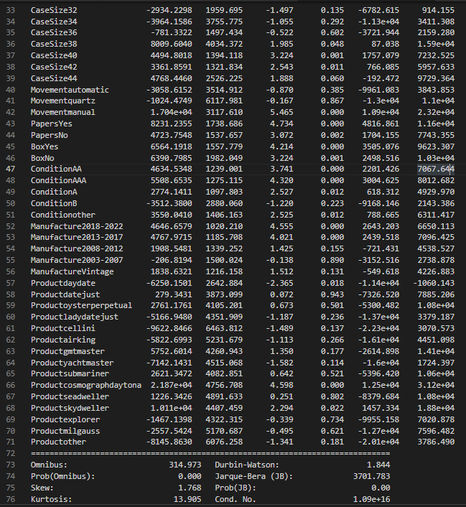

Slide 13
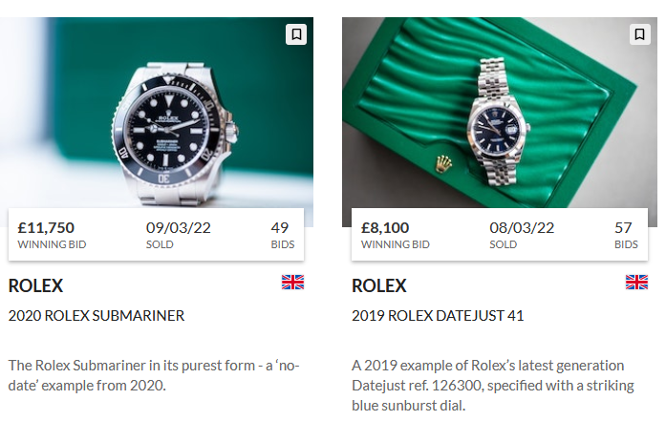

Slide 14
